Slide 1
NLP SENTIMENT
ANALYSIS
E-commerce Product Reviews
Kapil Amarsing Patil
Data Science and Gen Ai

Slide 2
Project Mentor and Participates Name
TEAM MEMBERS NAME:
MENTOR: ABHISHEKA KUVARI
KAPIL PATIL
PRUTHVIRAJ CHAUHAN
NAVEEN KUMAR
ANIKIT JARAG
MAYURI WAMAN
POTLOLA SAI DEEKSHITHA
KAJA NARAHARI

Slide 3
Title
Exploratory Data Analysis & Visualisation
Challenges & How I Overcame
Data Preprocessing
Conclusion
Model Building - Algorithms Tested & Key Decisions
Model Evaluation & Performance Metrics
Deployment Output - Streamlit Web Application
Business Observations & Requirements
Feature Categories

Slide 4
Business Objectives & Requirements
Primary Objective
Extract sentiment from customer reviews on e-commerce products
Dataset Details
• 1,440 product reviews
• Features: Title, Rating (1-5), Review Body
• Real e-commerce customer feedback
Deployment Requirement
Production-ready web application using Streamlit with interactive dashboard

Slide 5
Exploratory Data Analysis & Visualization
Key Findings
Visualization Insights
Dataset Composition
• 1,440 reviews analyzed
• Rating distribution: Bimodal (1★ & 5★)
• Average rating: 3.17 ± 1.58
Sentiment Distribution
• Positive: ~45% (rating ≥ 4)
• Negative: ~38% (rating ≤ 2)
• Neutral: ~17% (rating = 3)
Rating Distribution
Strong polarization: Users either love (5★) or hate (1★) products
Text Length Analysis
Negative reviews tend to be longer (detailed complaints)
Correlation Analysis
Perfect correlation between rating & sentiment (0.96) - validates labeling
Language Processing
Filtered to English-only reviews for model consistency

Slide 6
Data Preprocessing Pipeline
1. Merge
1. Text Combination
Combined 'title' and 'body' fields into unified text for analysis
2. Language Detection
Applied langdetect library to identify review language
3. Language Filtering
Retained only English reviews for model consistency
4. Text Cleaning
• Lowercasing • URL removal • Hashtag removal• Number removal
• Punctuation cleaning • Emoji handling
5. Feature Extraction
Generated text_length, VADER scores, and sentiment labels
2. Detect
3. Filter
4. Clean
5. Extract

Slide 7
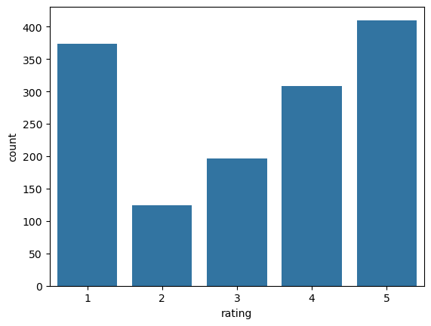
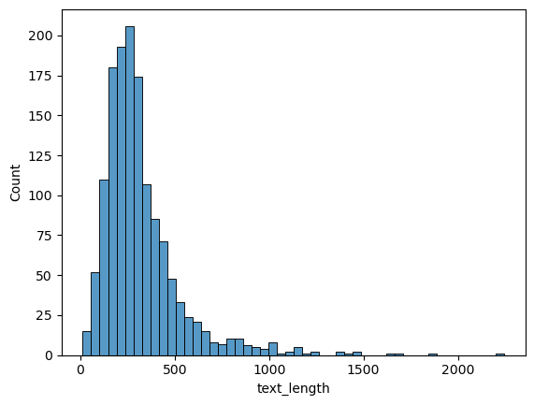
Exploratory Data Analysis -1
Rating of the product from 1 to 5
Reviews: Text Lengths
3. Filter
4. Clean
5. Extract

Slide 8
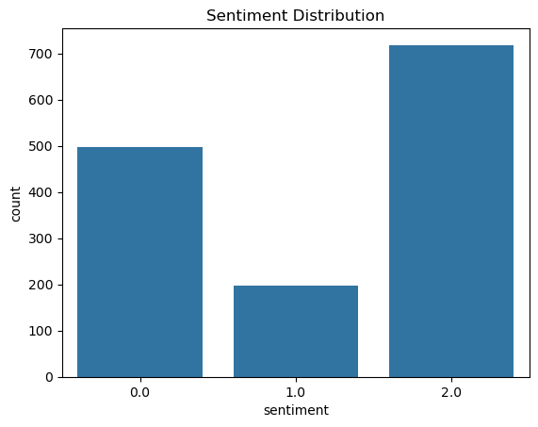
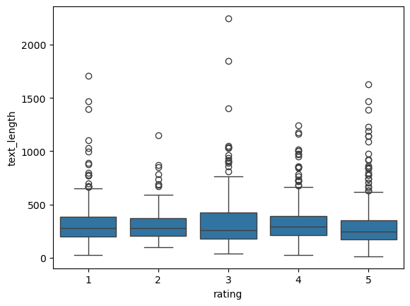
Exploratory Data Analysis -2
Box Plot: Rating vs Text length
Sentiment Mapping from Rating
3. Filter
4. Clean
5. Extract

Slide 9
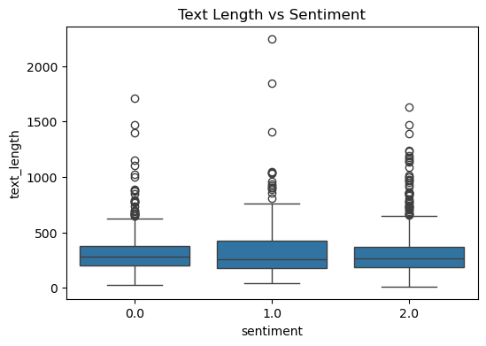
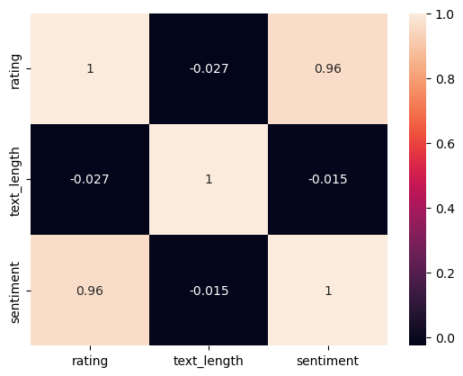
Exploratory Data Analysis -2
Box Plot: Text length vs Sentiment
Correlation Matrix
3. Filter
4. Clean
5. Extract

Slide 10
Feature Categories
Original Features
Engineered Features
VADER Analysis
• Title
Product review headline
• Rating
1-5 star scale
• Body
Full review text
• Combined Text
Title + Body merge
• Cleaned Text
Preprocessed content
• Text Length
Character count
• Sentiment Label
0=Neg, 1=Neu, 2=Pos
• VADER Score
Compound: -1 to +1
• VADER Sentiment
Pos/Neu/Neg label
• Sentiment Scores
Positive, Neutral, Negative

Slide 11
Feature Categories
📊 Original Rating Distribution (1-5 Stars)
🎯 Sentiment Mapping Logic
410
373
→
Positive
5★ + 4★
718 reviews (50.9%)
308
3★
→
Neutral
197
197 reviews (14%)
Count
124
2★ + 1★
→
Negative
497 reviews (35.2%)
💡 Insight: Polarized distribution - customers either love (1★) or hate (5★) products
1★
2★
3★
4★
5★

Slide 12
Model Building - Algorithms & Key Decisions
Feature Engineering Decision
Key Decisions
TF-IDF Vectorization
• N-grams: 1-2 (unigrams + bigrams)
• Max features: 5,000
• Captures word importance & context
• Better than simple bag-of-words
Train-Test Split
80% training, 20% testing
Stratified split to maintain class distribution
Class Imbalance Handling
Applied class_weight='balanced'
Prevents bias toward majority class
Algorithms Tested (5 Models)
Stop word Strategy
Retained negation words (not, no, never)
Critical for sentiment nuance
Model | Type | Key Feature
Logistic Regression | Linear | Class balancing
Multinomial NB | Probabilistic | Fast baseline
Linear SVC | Max-margin | Class balancing
Random Forest | Ensemble | 100 trees
Gradient Boosting | Ensemble | Sequential learning
VADER Integration
Incorporated rule-based sentiment analysis
Provides interpretable baseline comparison

Slide 13
Model Evaluation & Performance Metrics
Model Performance Comparison
Model | Accuracy | Strength | Weakness
Logistic Regression | 77% | Overall good, fast | Linear assumption
Multinomial NB | 75% | Very fast | Independence assumption
Linear SVC ✓ | 79% | Best Boundary | Computationally heavy
Random Forest | 76% | Non-linear | Slower training
Gradient Boosting | 76% | Robust | Risk of overfit
🏆 Selected Model: Linear SVC
79%
76%
79%
77%
Overall Accuracy
Avg Precision
Avg Recall
F1-Score

Slide 14
Deployment - Streamlit Web Application
Application Architecture
User Interface
Streamlit Dashboard
Processing
TF-IDF Vectorizer
ML Model
Linear SVM
Key Features
Technical Stack
✓ Real-time Prediction
Input custom review text for instant sentiment analysis
✓ VADER Comparison
Side-by-side ML vs rule-based predictions
✓ Interactive Visualizations
Dataset distribution charts
✓ Word-level Analysis
VADER lexicon breakdown for input reviews
Component | Technology
Frontend | Streamlit
ML Framework | scikit-learn
NLP | NLTK, VADER
Visualization | Matplotlib
Deployment | Streamlit / FastAPI (Optional)
Serialization | Pickle (.pkl)

Slide 15
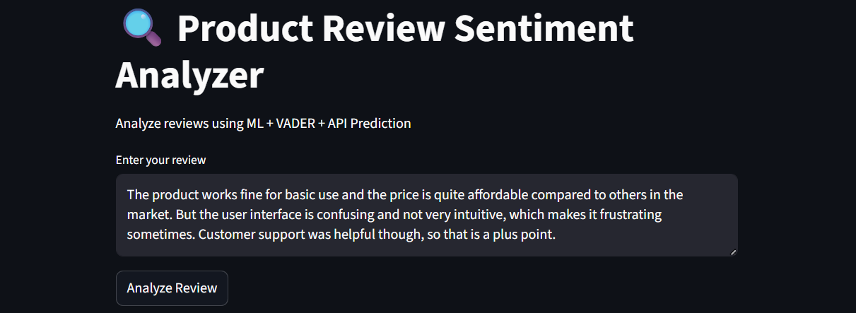
Screenshot- 1 - Streamlit Web Application
Enter the Review here:-

Slide 16
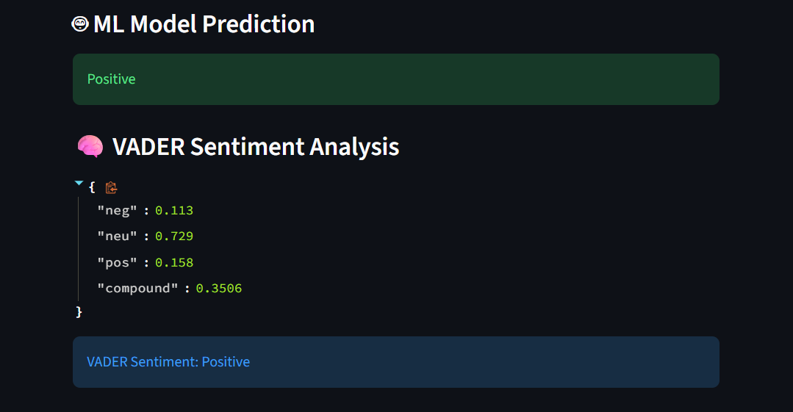
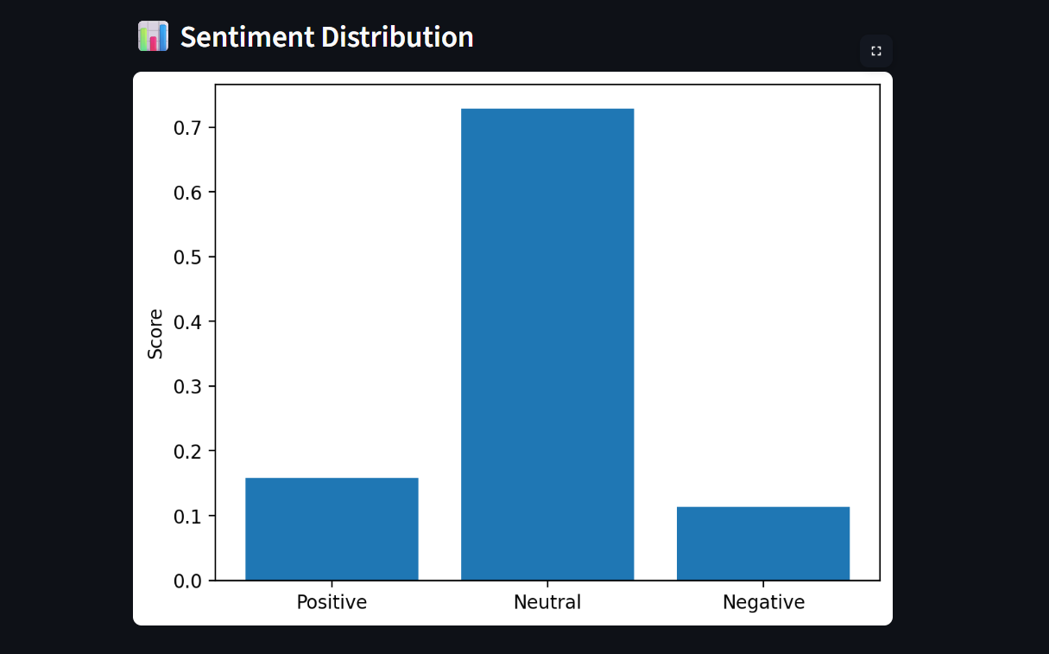
Screenshot- 2 - Streamlit Web Application

Slide 17
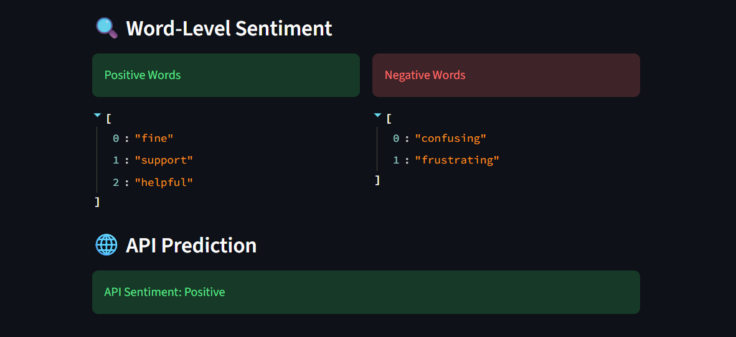
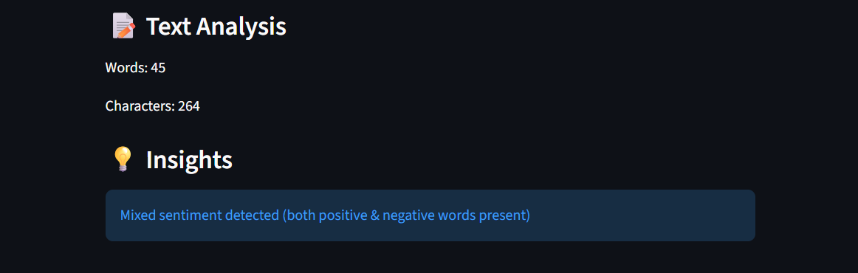
Screenshot- 3 - Streamlit Web Application

Slide 18
Challenges & How I Overcame Them
⚠️ Class Imbalance Dataset had uneven distribution across sentiment classes (more positive/negative than neutral)
✓ Solution Applied class_weight='balanced' in models to penalize majority class errors more heavily
⚠️ Text Noise Reviews contained URLs, emojis, special characters and inconsistent formatting
✓ Solution Built comprehensive preprocessing pipeline: URL removal, emoji handling, punctuation normalization
⚠️ Language Diversity Dataset contained non-English reviews that would confuse English-trained models
✓ Solution Used langdetect library to filter and retain only English reviews for consistent model performance
⚠️ Negation Sensitivity Standard stopword removal eliminated important sentiment-reversing words (not, never, no)
✓ Solution Customized stopword list to preserve negation terms, improving sentiment detection accuracy

Slide 19
Conclusion & Key Takeaways
This project demonstrates that while traditional NLP models like TF-IDF + SVM are powerful and efficient, understanding human language requires deeper contextual models and better data representation.
Built a sentiment analysis system using TF-IDF + SVC
Achieved ~79% accuracy
Learned importance of pre-processing and feature engineering
Identified limitations in handling neutral and mixed sentiment
Successfully deployed using Streamlit
Thank You!

